Slide 1


Generative AI
Full Stack Developer

Slide 2
Course C :
Developing Applications with LLM

Slide 3
04
Function Calling
with
Gemini & LangChain

Slide 4
Agenda
Course Finder App
Objectives:
Learn how to connect Gemini LLM to external APIs using LangChain.
Build a Course Finder App that fetches real-time course data using Google Search or SerpAPI.

Slide 5





What is Function Calling?
Function calling lets LLMs execute external API calls for dynamic data. Moves LLMs from static text generation to real-time tasks.
Gemini
Understanding request..
“I need to call an API to get the data”
Example: Course Finder fetching live courses from multiple platforms.
API
Connects AI models to external services
data
Enables real-time data access
courses
price
Extends LLM capabilities beyond static responses

Slide 6




High Level - Flow
User asks for a course (e.g., 'Python course under $200').
Gemini interprets the query and identifies intent + filters.
If real-time data is needed → calls Google Search / SerpAPI.
API returns structured course data (JSON).
Gemini formats results and presents to the user.
“Python course under $200
Gemini
Interprets & identifies filters
SerpAPI
Interprets & identifies filters
Results
Formatted course suggestions

Slide 7
Architecture
User Interface
User query input via Streamlit/Chainlit
Frontend: Streamlit or Chainlit UI for user input.
LLM Layer: Gemini via LangChain for natural language understanding. Function Layer: API functions to search courses online. Backend Flow: User → Gemini → Function → SerpAPI → Gemini → User.
Gemini LLM
Natural language understanding via LangChain
Function Layer / SerpAPI
External API functions for course search
Results
Formatted and returned to user

Slide 8


Data & Information Flow
Text Input
"Find Python courses under $200"
Gemini
User Input: Free-text query.
Prompt Processing: Gemini extracts intent and filters. Function Schema: Determines whether to fetch static data or call SerpAPI/Google Search. API Response: JSON with course titles, links, prices, durations. LLM Consumption: Converts JSON into readable summary for user.
Extracts intent: topic="Python", price="<$200"
SerpAPI
Fetches real-time course data
JSON Data
Structured course information
User Summary
Formatted results for user

Slide 9
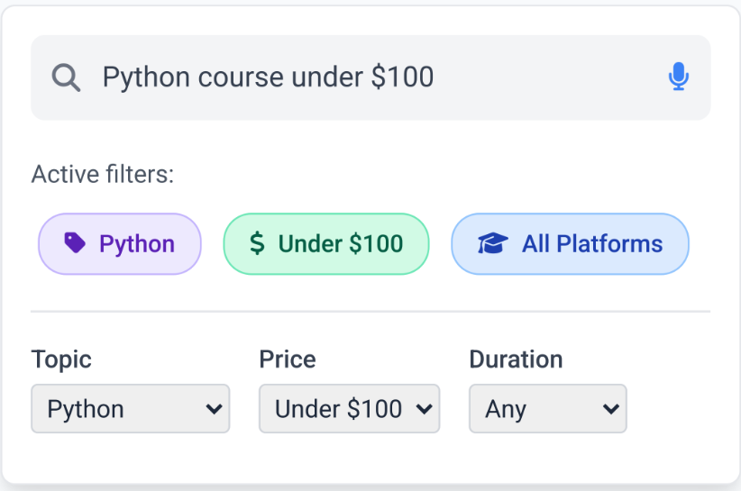
Prompt Filters
Add filters to refine results:
Topic Filter → AI, Data Science, Finance
Price Filter → Free, Under $50, Under $100, Premium Duration Filter → <10 hrs, 10–30 hrs, >30 hrs Platform Filter → CodeHub AI, Udemy, etc.,

Slide 10
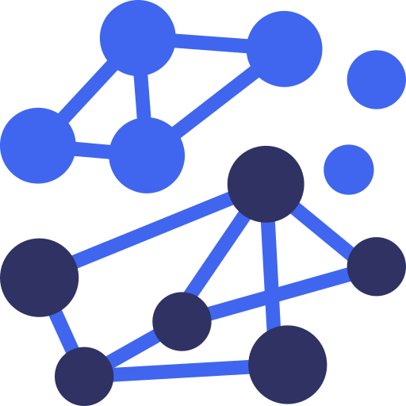
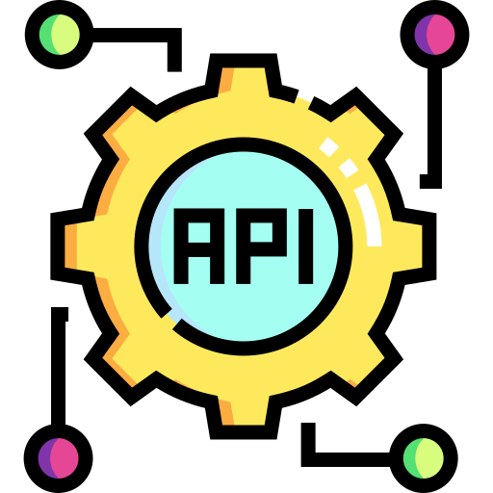

FunctionDeclaration(
name='search_courses_online',
description='Search courses online using Google Search / SerpAPI',
parameters={
'topic': 'str',
'price_range': 'str',
'duration': 'str',
'platform': 'str',
'max_results': 'int'
},
output={
'courses': [
{'title': 'str', 'link': 'str', 'price': 'str', 'duration': 'str'}
]
}
)
# When function is called, LLM provides arguments based on user intent
# Example: search_courses_online(
# topic='python',
# price_range='under $100',
# platform='Udemy',
# duration='<10 hrs',
# max_results=3
# )
Function Schema
Function schema for real-time course search:
Gemini
SerAPI
JSON

Slide 11

from langchain_google_genai import ChatGoogleGenerativeAI
from langchain.schema import FunctionDeclaration
import requests
# Initialize Gemini LLM via LangChain
llm = ChatGoogleGenerativeAI(model='gemini-pro')
# Define function to search courses using SerpAPI
def search_courses_online(topic, price_range, duration, platform, max_results=5):
params = {
'engine': 'google',
'q': f'{topic} courses {platform} {price_range} {duration}',
'api_key': 'YOUR_SERPAPI_KEY'
}
response = requests.get('https://serpapi.com/search', params=params).json()
courses = [{
'title': r['title'],
'link': r['link'],
'price': r.get('price','N/A'),
'duration': r.get('duration','N/A')
} for r in response['organic_results'][:max_results]]
return {'courses': courses}
# Create LangChain function declaration
course_search_function = FunctionDeclaration(
name='search_courses_online',
description='Search courses online with filters using SerpAPI',
parameters={'topic': 'str', 'price_range': 'str', ...}
)
LangChain +
Gemini + SerpAPI
Setup
LangChain
Gemini
SerAPI

Slide 12
Example Run
User
"Find a beginner AI course under $350 on CodeHub AI."
Let's walk through a complete example:
User Query: "Find a beginner AI course under $350 on CodeHub AI."
Intent Detection: Gemini identifies this as a course search with specific filters.
Function Call: Gemini calls
search_courses_online() with extracted
parameters.
API Response: SerpAPI returns structured JSON data.
Formatting: Gemini processes JSON and presents user- friendly results.
Gemini
I need to search for AI courses with specific parameters.
search_courses_online(topic='AI', price_range='<350',
platform='Codehubai')
SerAPI
{
"courses": [
{"title": "AI For Everyone", "price": "$150", "platform":
"codehubai"},
{"title": "Intro to Machine Learning", "price": "$200", "platform":
"codehubai"},
{"title": "Neural Networks Basics", "price": "$300", "platform":
"codehubai"}
]
}
Gemini
"Here are 3 beginner AI courses under $350 on CodeHubAI:
AI For Everyone ($150)
Intro to Machine Learning ($200)
Neural Networks Basics ($300)

Slide 13





Summary & Applications
Function calling enables dynamic, actionable LLM applications:
Example: Course Finder fetching live courses from multiple platforms.
Course Finder (education)
Travel Planner (real-time itineraries)
Stock Market Query (financial data)
Recipe Finder (cooking apps)
Applications
Key Takeaway: Function calling + SerpAPI extends LLMs beyond static
answers → real-time, user-tailored results.

Slide 14
Q/A

Slide 15
Thanks

